Slide 1
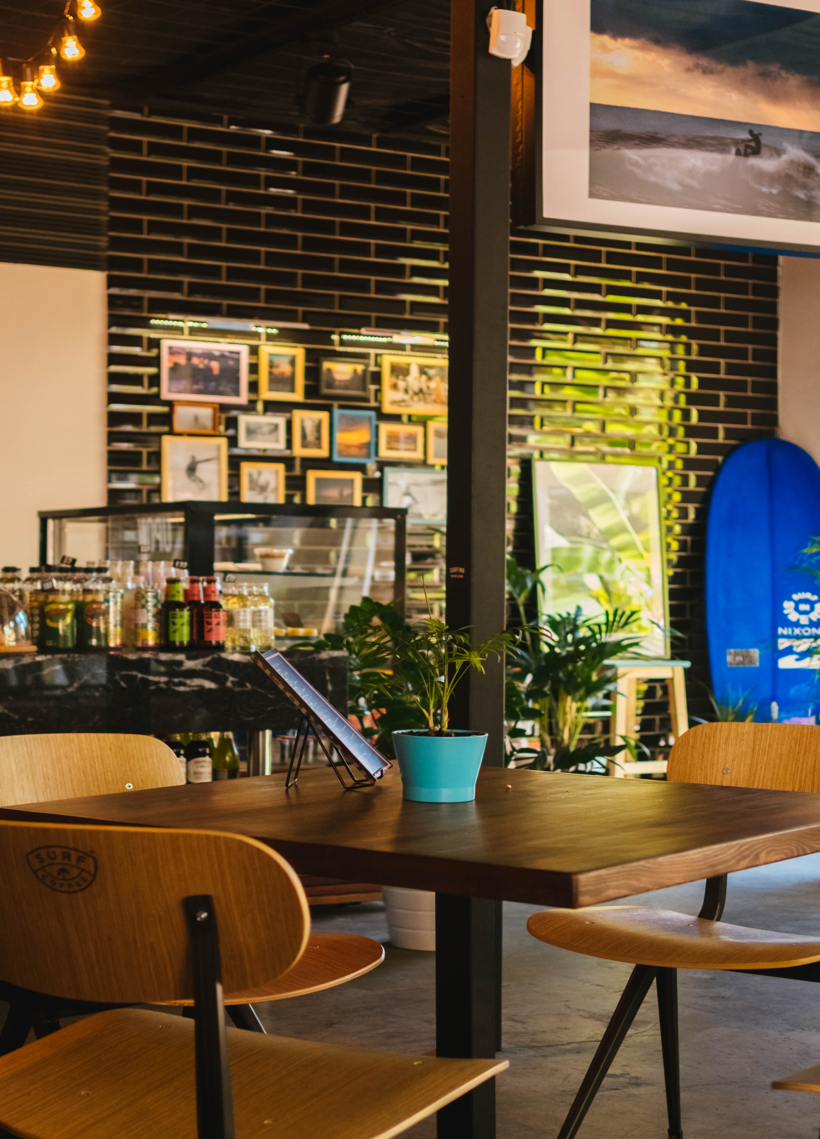
TIK TOK CAFÉ SYSTEM
Making delicious
appetizing food
“Feels Like Home, Tastes
Like a Paradise”

Slide 2
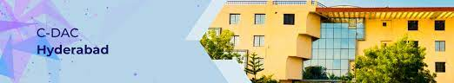

TIK TOK CAFE SYSTEM
SUBMITTED
FOR
DIPLOMA IN ADVANCED COMPUTING FROM
CDAC HYDRABAD
PRENSENTED BY:
230350320101 - Satyajit C. Pakhale
230350320110 - Shubham P. Kumbhar
230350320107 - Shraddha C. Mate
230350320104 - Shivam A. Molawane
230350320103 - Rohan S. Sayare

Slide 3
Contents of this project
01
02
03
04
05
06
Introduction
Existing System
Need & Scope
Here we describe the topic of the section Welcome to “Tik Tok Cafe”
Creates a sense of community among users
Users can gather, connect, and showcase their creativity
Major Requirement
Software Requirement, Hardware Requirement
Proposed system
System Development Life Cycle
Introduce a digital ordering and payment system
Implementing new features or making optimizations

Slide 4
System contents & features
07
 | 1) User page 2) User Register & 3) User login 4) Book Table 5) Menu Card 6) User Feedback 7) Staff Login & 8) Mark Presently 9) Take Order & 9) Bill generation 10) Staff order & 11) Admin login 12) Admin Dashboard 13) Employee list 14) Generate Salaries 15) Feedback

Slide 5


01
Introduction
Tik Tok Cafe is a web application.
Developed to automate day to day activity of the cafe.
This Tik Tok Cafe system can be used by the staff ,manager , owner and also customer.
This system managing orders and billing will become easier and systematic to replace traditional system where all still using paper.
The main aim of developing this system is to help the cafe management to manage the cafe easily and quickly.

Slide 6
Existing System
At present the cafe management manages their day to day transactions where a waiter has to go at each table and takes the order, And give to the chief and then must be passed to cashier .
During this process it takes lots of time and customer must wait till the process.
Limitations Of Existing System
Existing system is completely depending on manual work i.e taking orders from customers passing it to kitchen and cash counter.
Existing system is more time consuming.
In existing system all the calculations are made manually.
In Existing system user can book the table after reaching at cafe.

Slide 7
Need And Scope
In very short time , the collection will be obvious ,simple and sensible. It will help in all works relative to café management.
Our project aims to computerize various processes of cafe.
In computer system the person has to fill various forms and number of copies of the forms can be easily generated at a time.
In computer system, it is not necessary to create the manifest but can directly print it, which saves our time.
It satisfies the user requirement.
Is easy to understand by user and operator.
Has a good user interface.

Slide 8
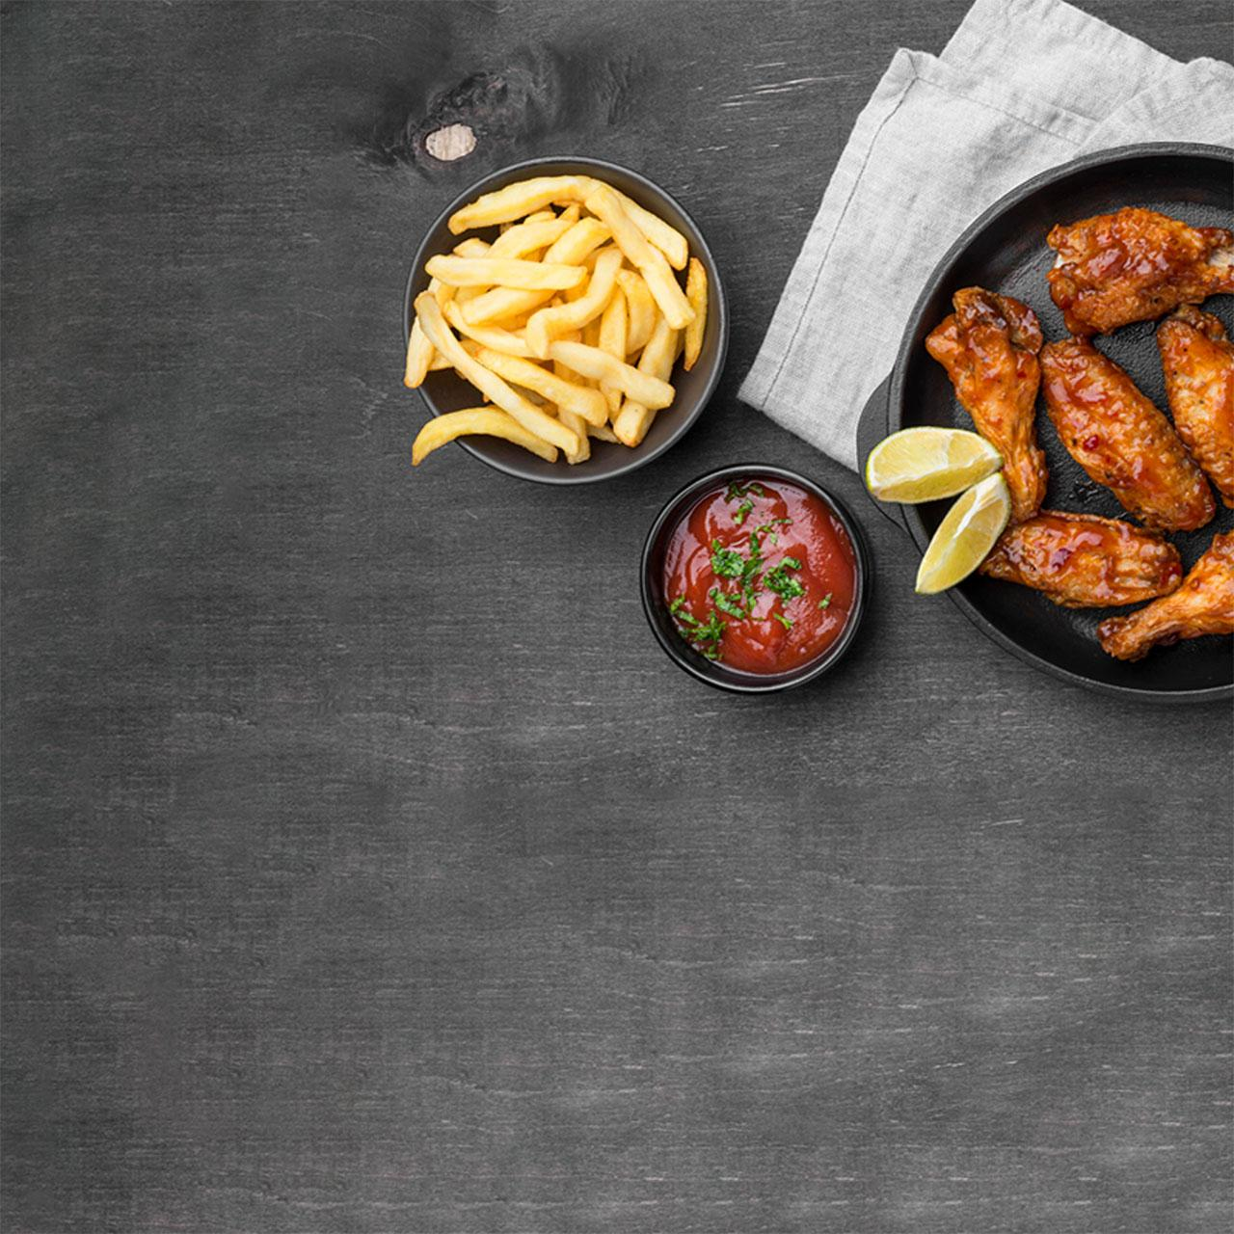
Proposed System
The proposed system provides user friendly interface and also provides powerful and efficient database management system.
The aim of proposed system is to develop a system of improved facilities.
The existing system work is done manually thus hampering its accuracy and effectiveness.
The proposed system can overcome the limitations of existing system.
The system provides security and reduce the manual work.
The existing system has several disadvantages and many more difficulties to work.
The proposed system tries to eliminate or reduce these difficulties upto some extent.
Help the staff to reduce the workload and mental conflict.
Possible to print various reports and bills easily and in less time

Slide 9

Advantages Of Proposed System
Security of data.
Ensures data accuracy.
Minimum time needed for various processes.
Better service.
User friendly UI.

Slide 10
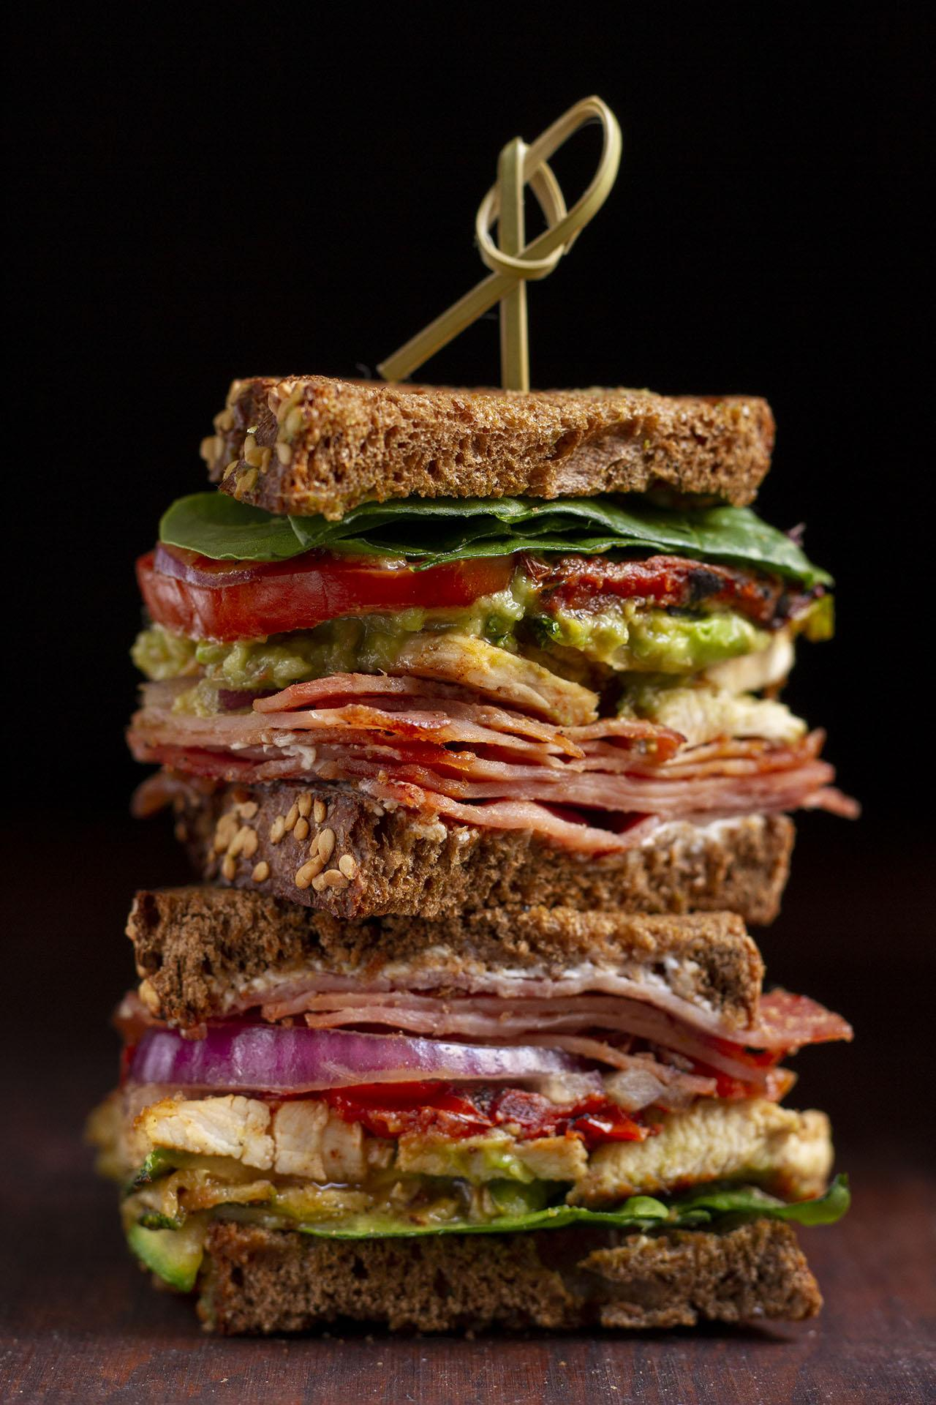
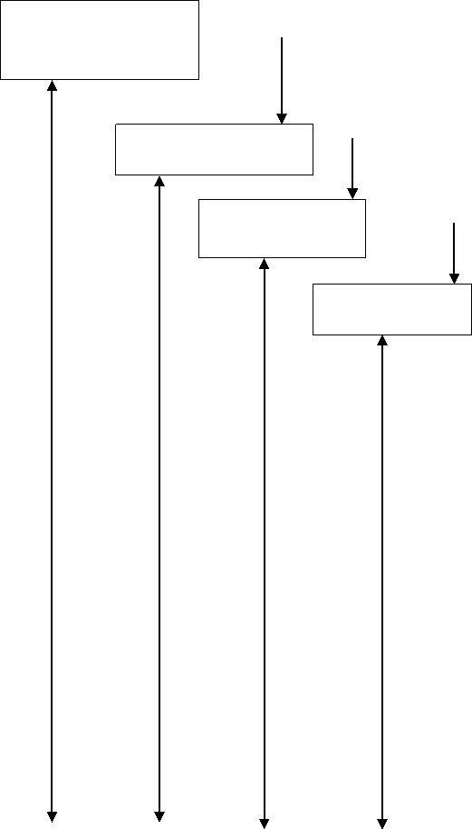
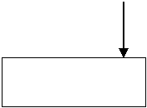
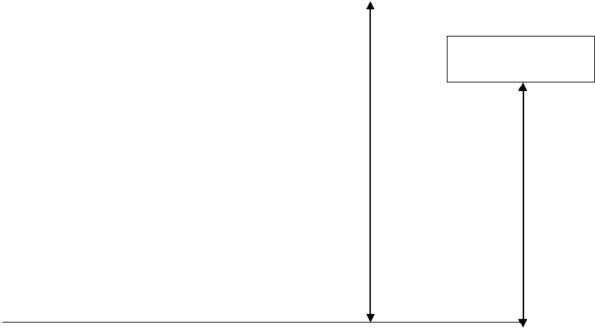
System Development Life Cycle
System Requirement
The process model used for this system “classic life cycle “as this Is simple and is best for small scale project
Analysis
Design
Code
Testing
Maintenance

Slide 11
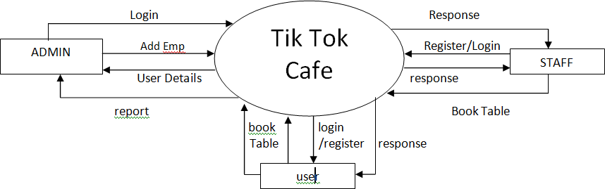
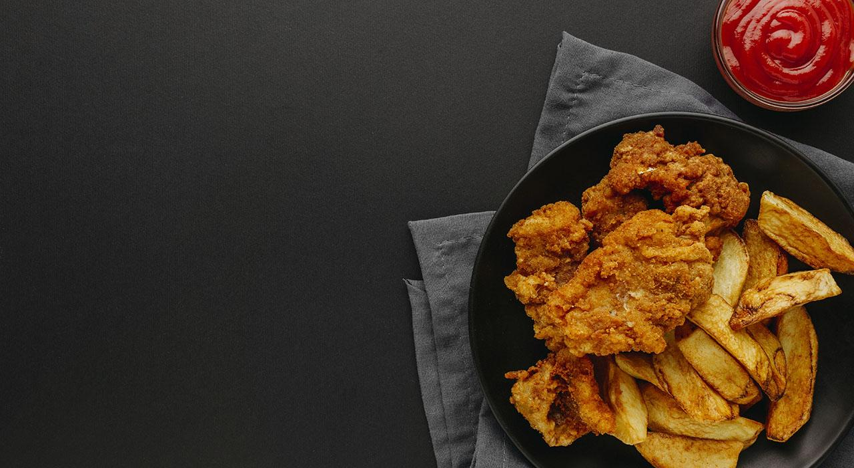
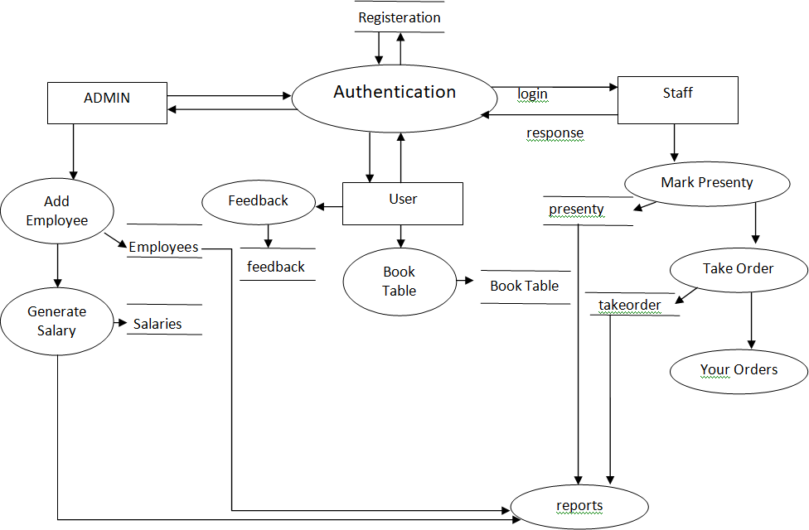
0th Level DFD :-
1st Level DFD :-

Slide 12
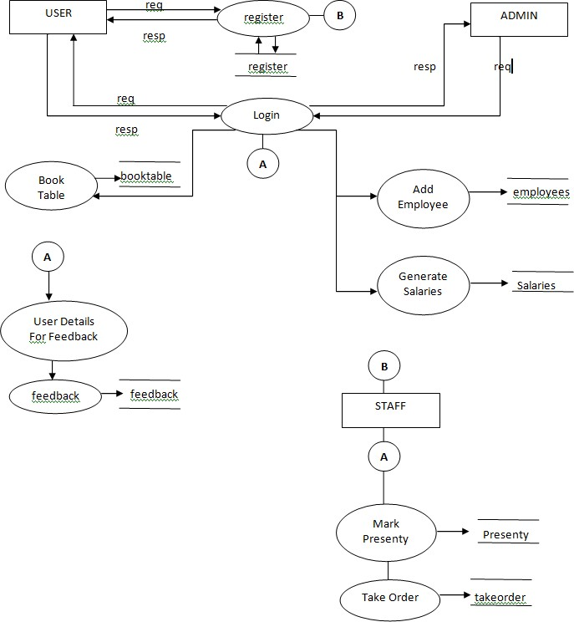
2nd Level DFD :-

Slide 13
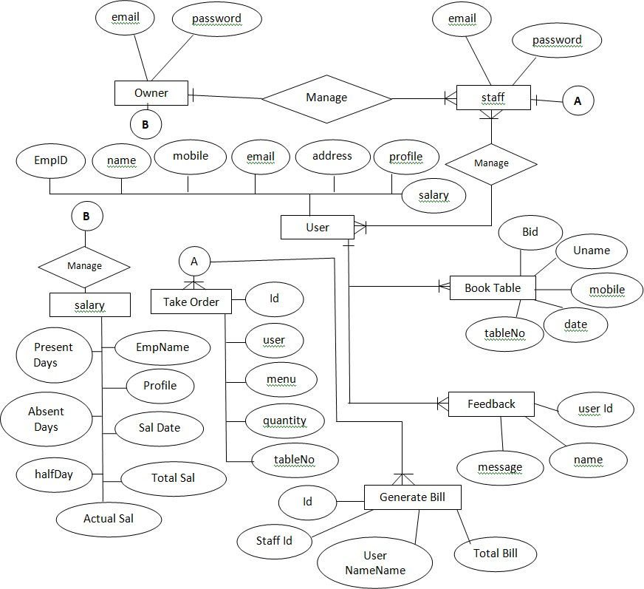
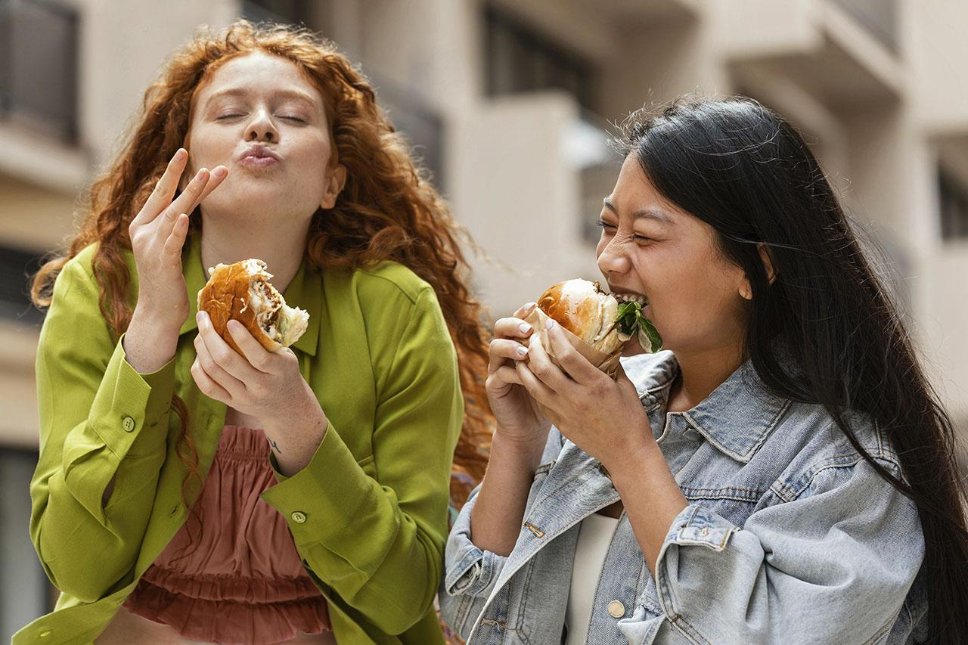
Entity Relationship Diagram :-

Slide 14
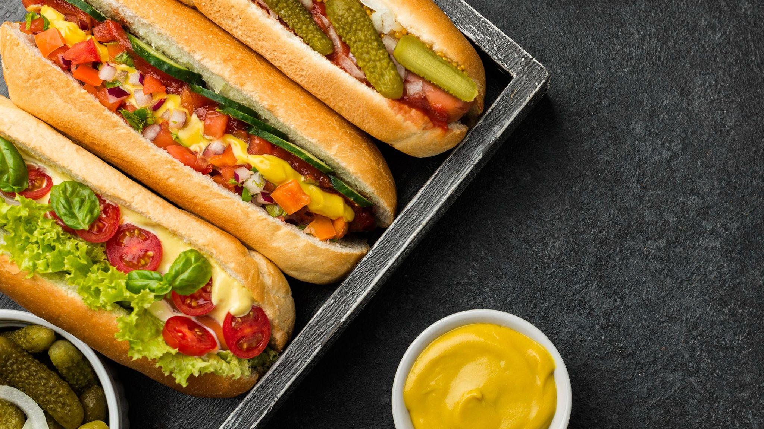
System Requirement
Software Requirement
Web Browser: Any of Mozilla, Opera, chrome etc
Eclipse-IDE (2021-06)
Operating System: Windows 10 or above.
Software Development kit: java JDK 1.7 or above.
Database JDBC Driver: MySql Connectors
Hardware Requirement
RAM: 4GB or more
Hard Disk: 20GB or More
Keyboard: Normal
Mouse: Compatible Mouse

Slide 15
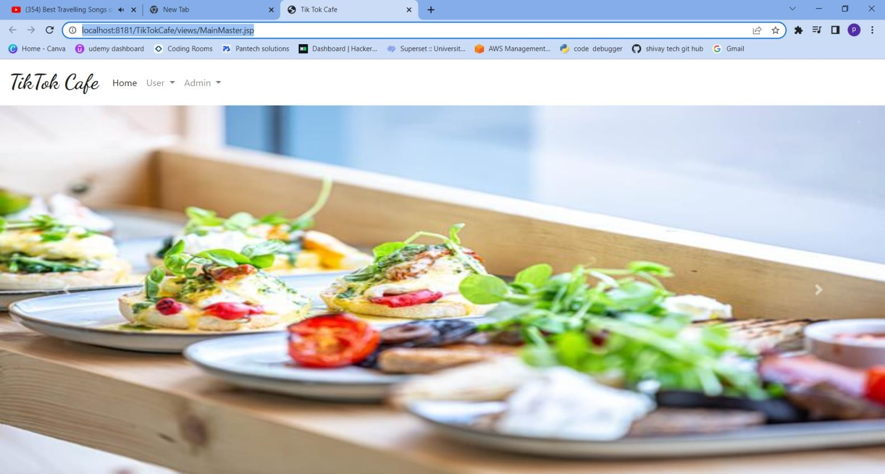
Home Page

Slide 16
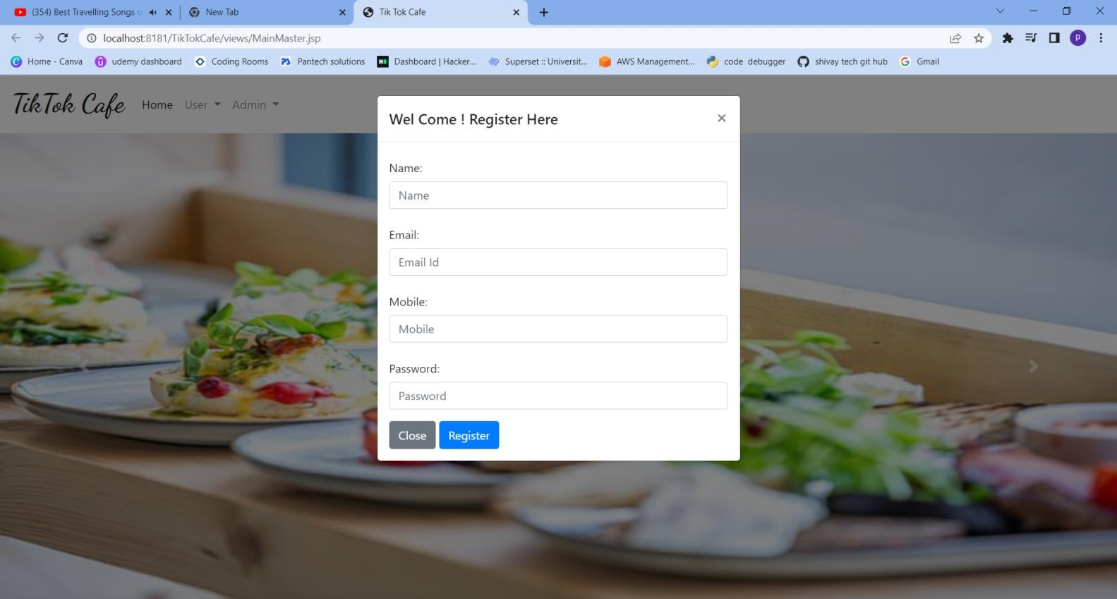
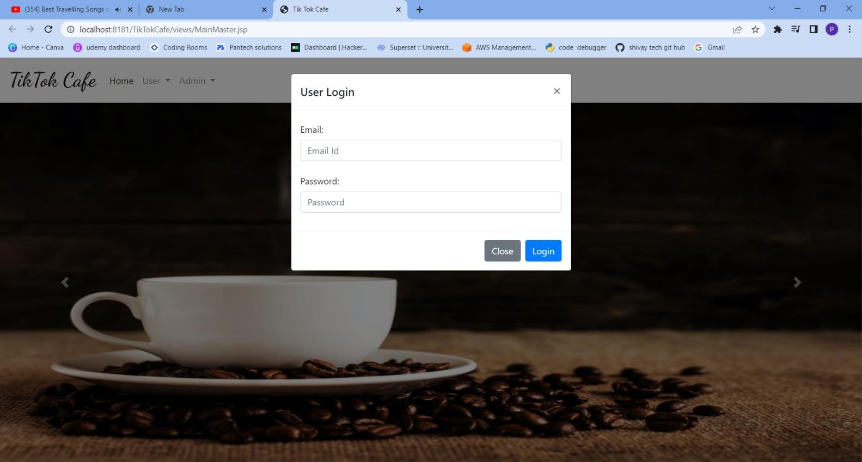
User Register
User Login

Slide 17
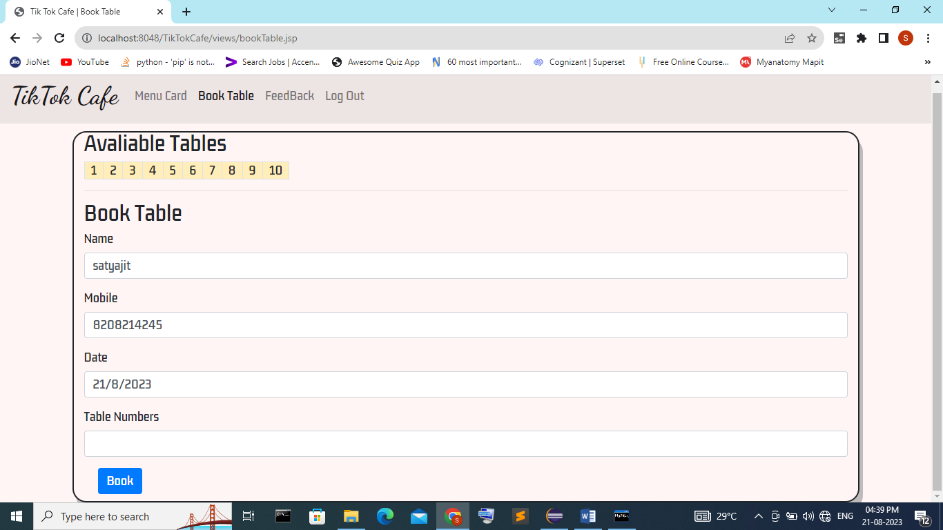
Book Table

Slide 18
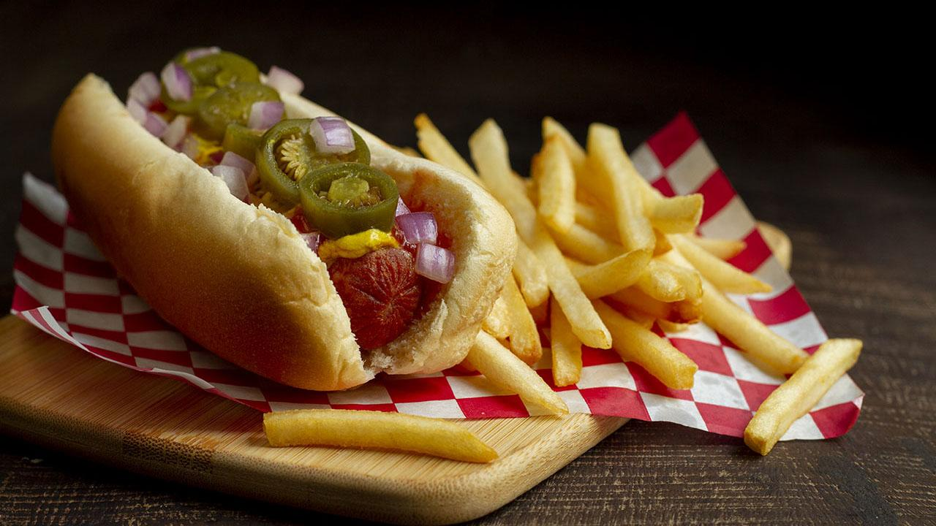
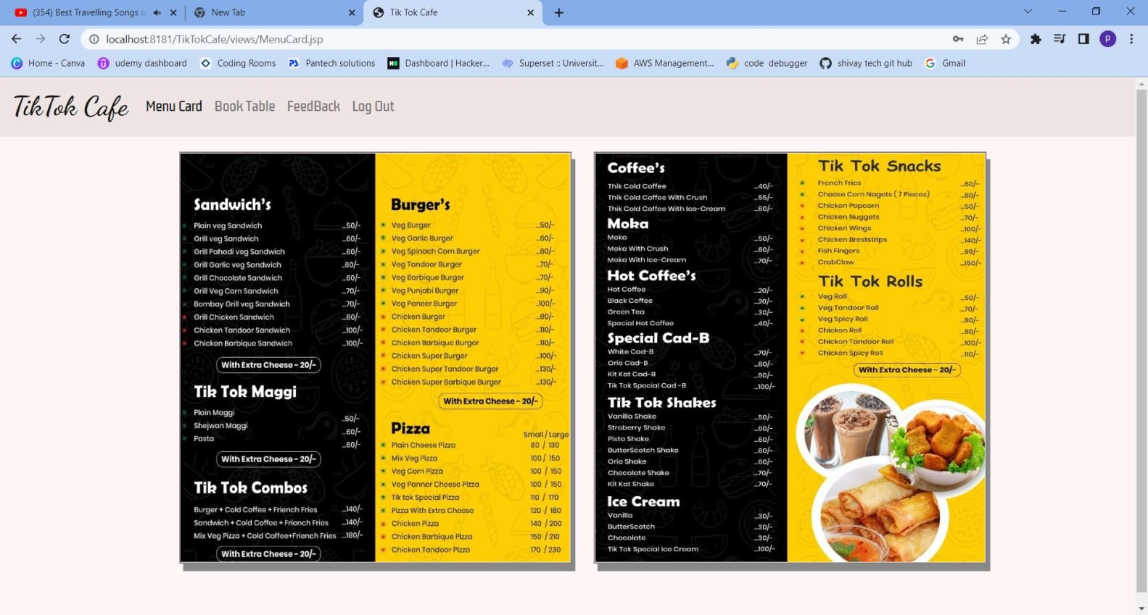
Menu Card

Slide 19
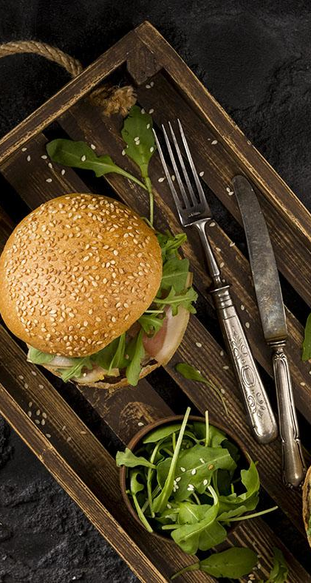
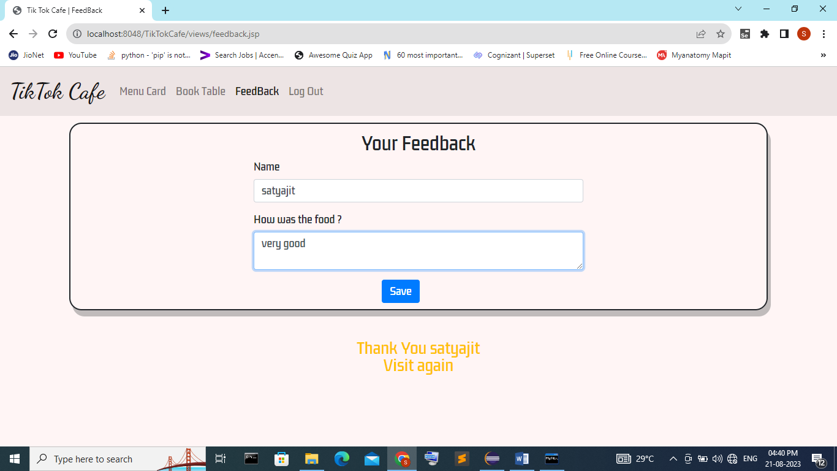
User Feedback

Slide 20
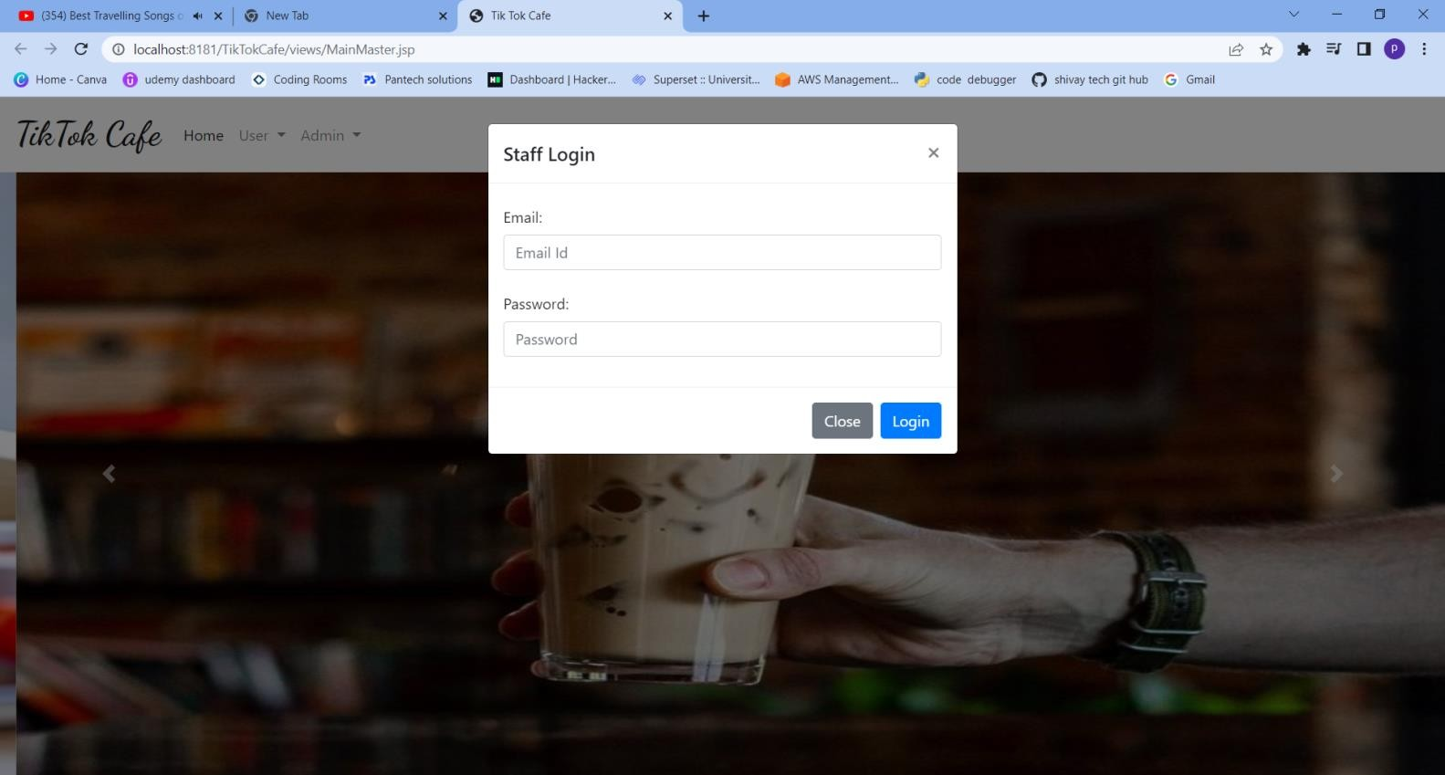
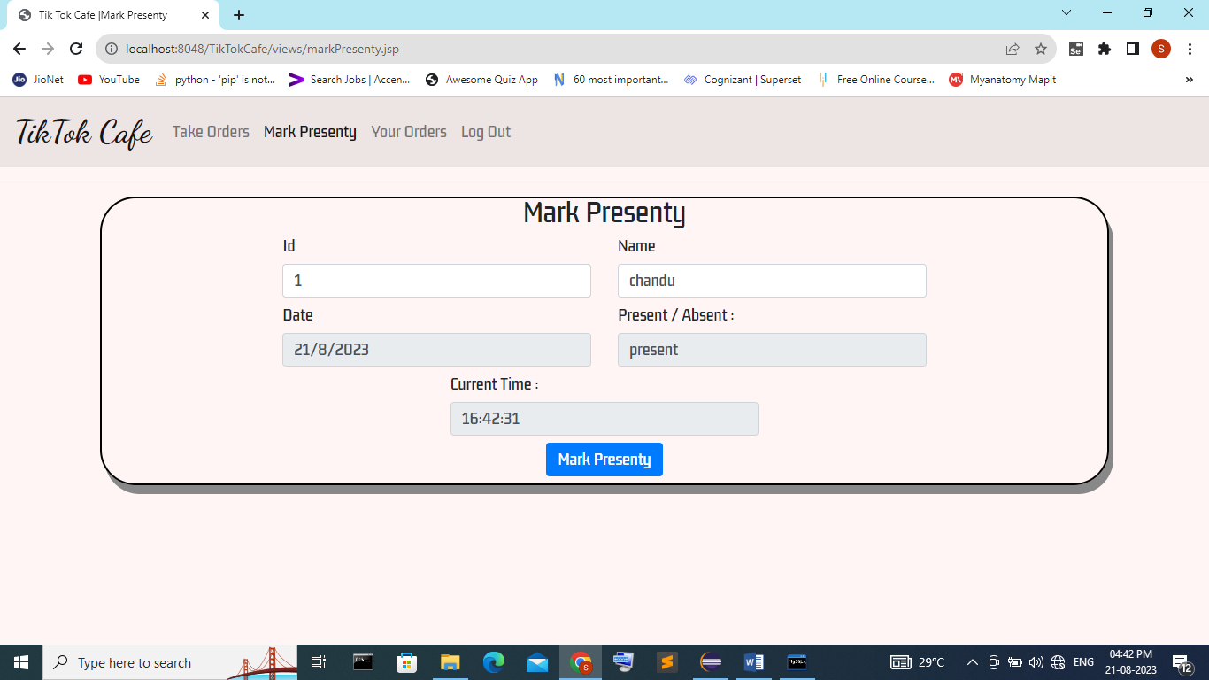
Staff Login
Mark Presenty

Slide 21
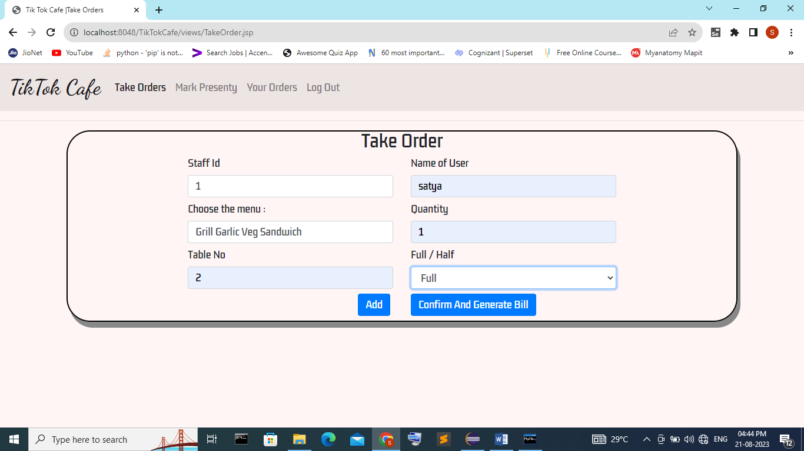
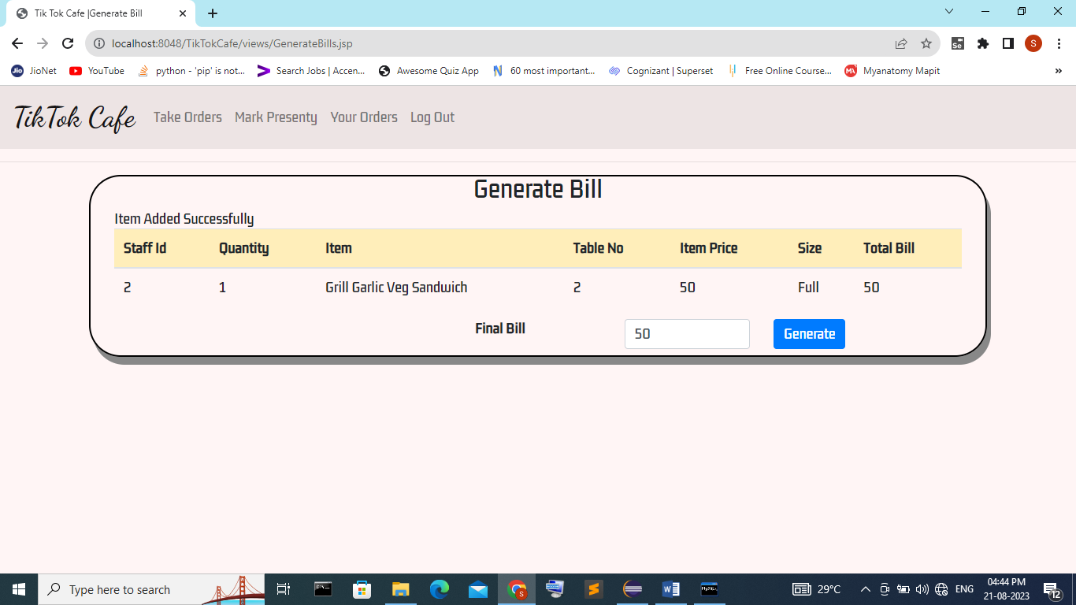
Take Order
Bill Generation

Slide 22
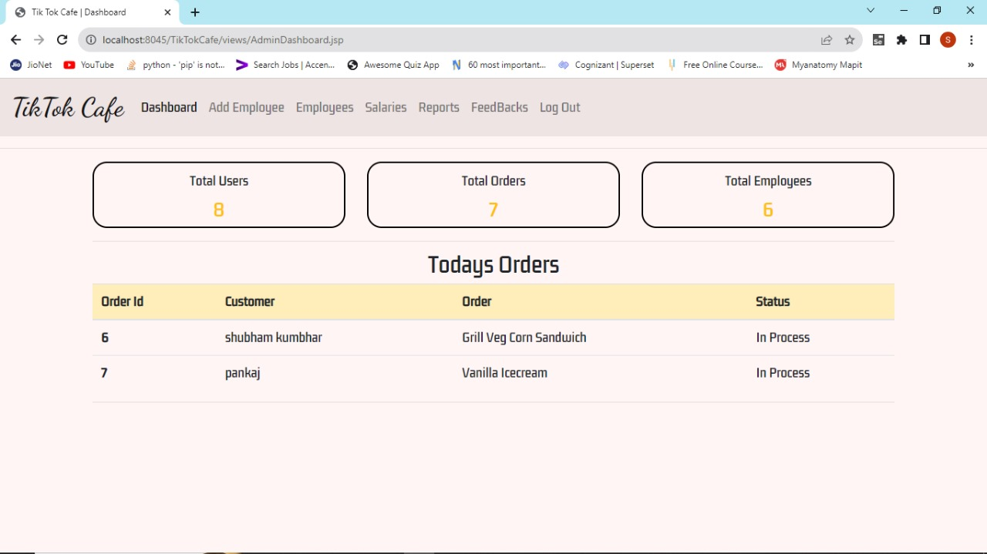
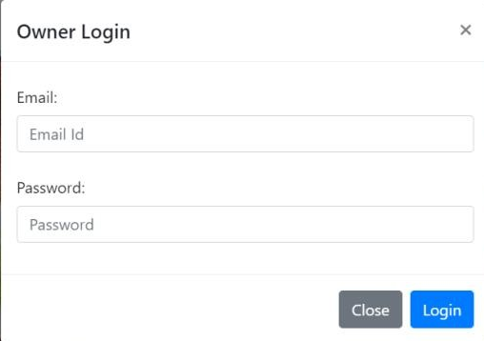
Staff Orders
Admin login

Slide 23

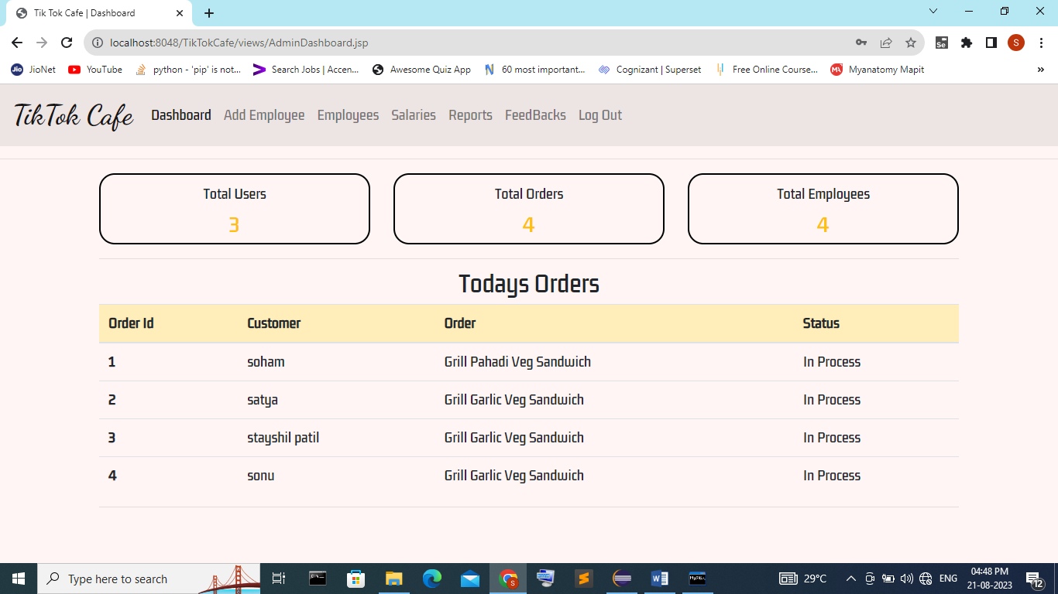
Admin Dashboard

Slide 24
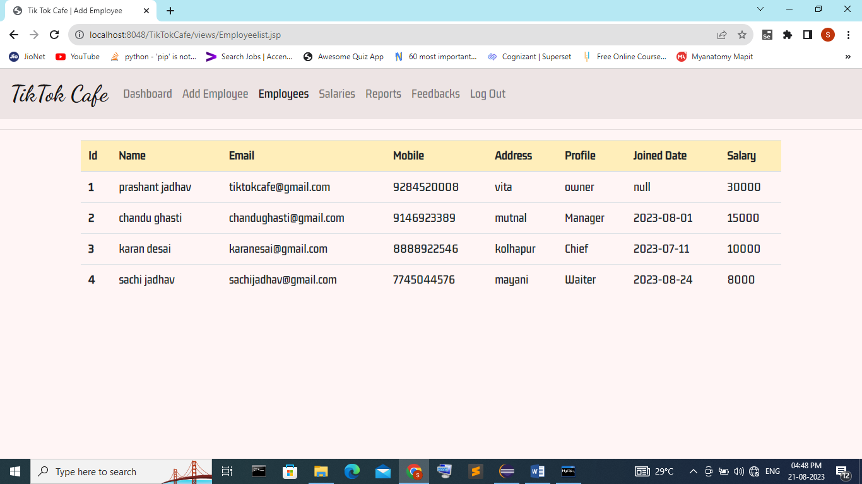
Employee List

Slide 25
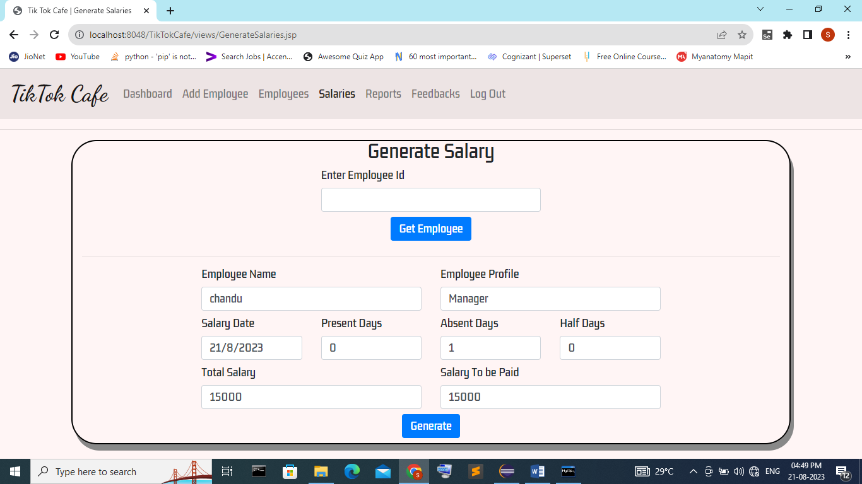
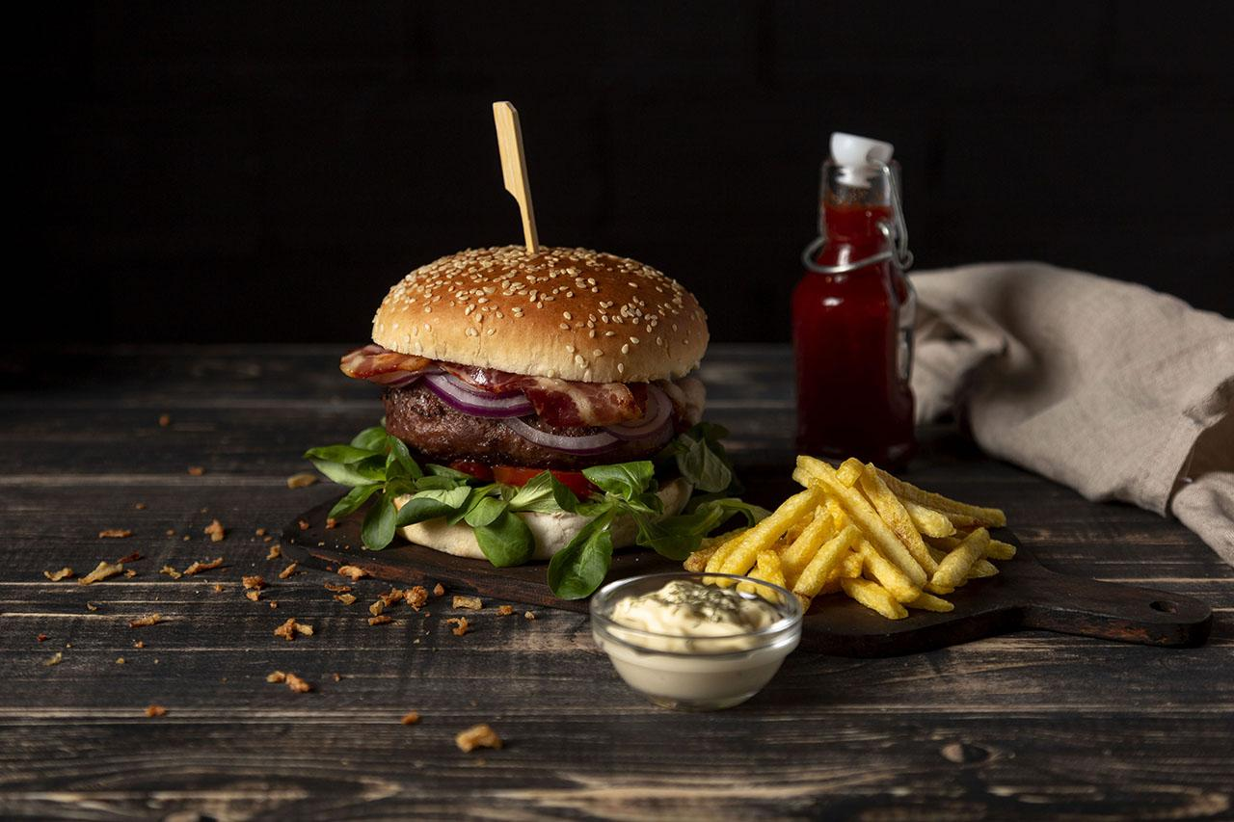
Generate Salaries

Slide 26
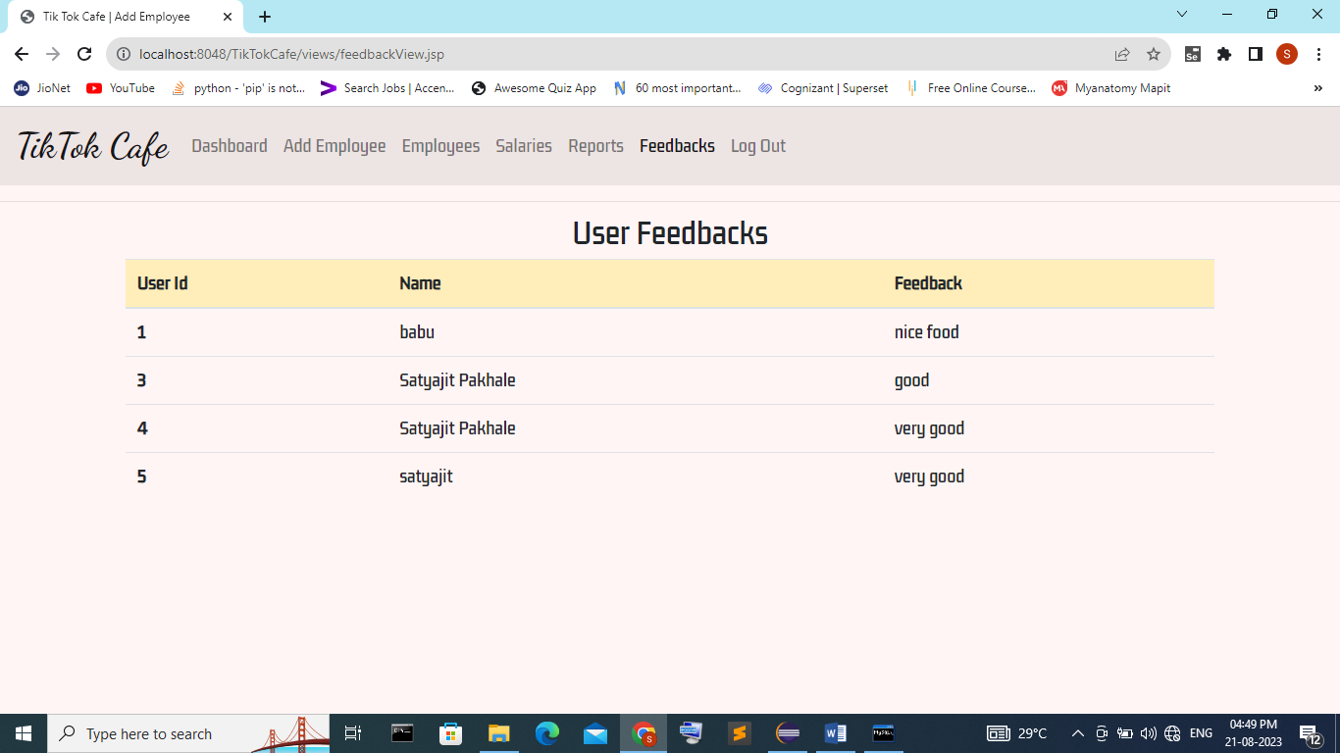
Feedbacks

Slide 27
Conclusion And Suggestions
After designing and implementation of this system we have come to following conclusion :
Due to computerization , a lot of time is saved.
Changes can be made immediately.
Due to this system admin can manage employees, salaries etc easily.

Slide 28

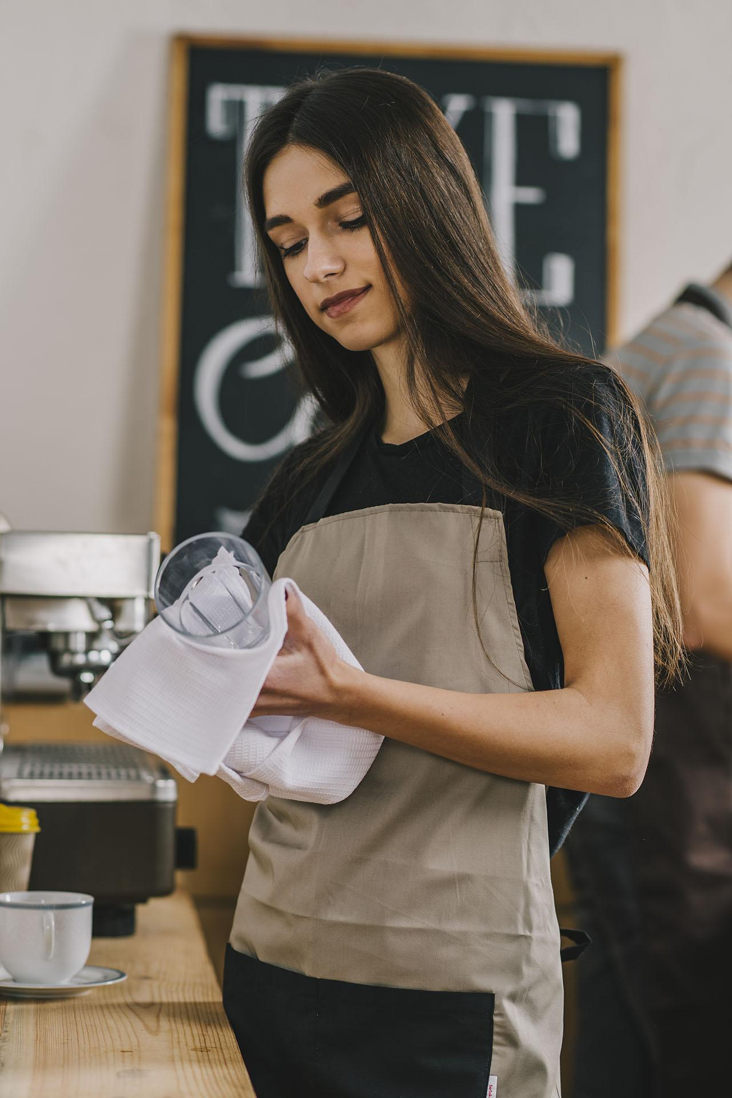
Bibliography
Nguyen, T. H., & Smith, J. M. (Year). "Adoption and Impact of E Cafe Systems on Cafe Operations: A Comparative Analysis." *Journal of Business and Hospitality Technology*, 15(1), 73-90
Wilson, R. S., & Turner, L. P. (Year). "Exploring Customer Perceptions of E Cafe Systems in Modern Cafes." *International Journal of Consumer Studies*, 34(4), 358-375
Rodriguez, M. A., & Anderson, D. S. (Year). "An Empirical Study of E Cafe System Implementation in Urban Cafes." *Journal of Hospitality Information Management*, 25(2), 189-205
Lee, S. Y., & Harris, B. R. (Year). "Innovations in Cafe Management: A Study of E Cafe Systems." *International Journal of Hospitality Management*, 20(3), 315-330.

Slide 29
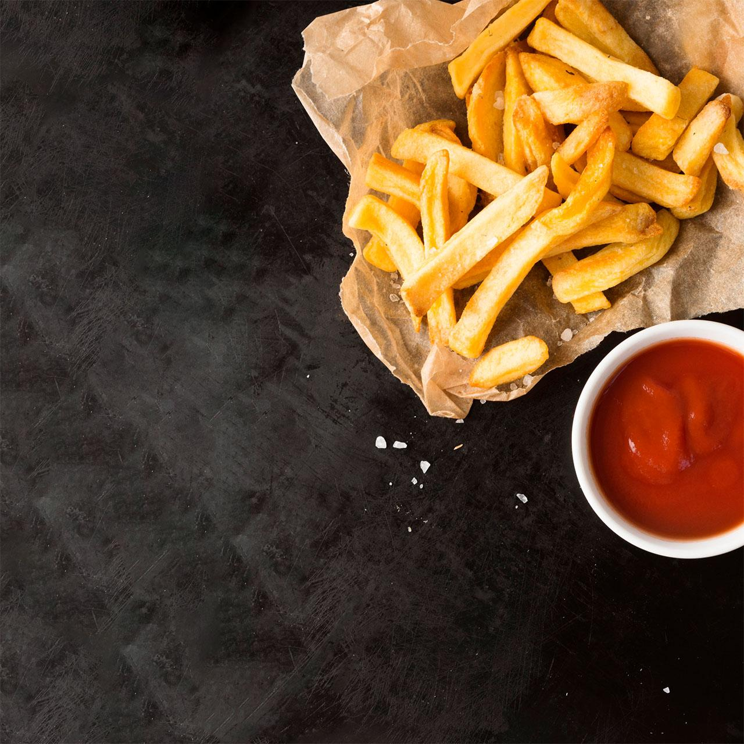
TEAM MEMBERS AND THEIR ROLES
FRONTEND : SHIVAM MOLWANE AND SHRADDHA MATE
BACKEND : SATYAJIT PAKHALE AND SHUBHAM KUMBHARE
DATABASE : ROHAN SAYARE

Slide 30
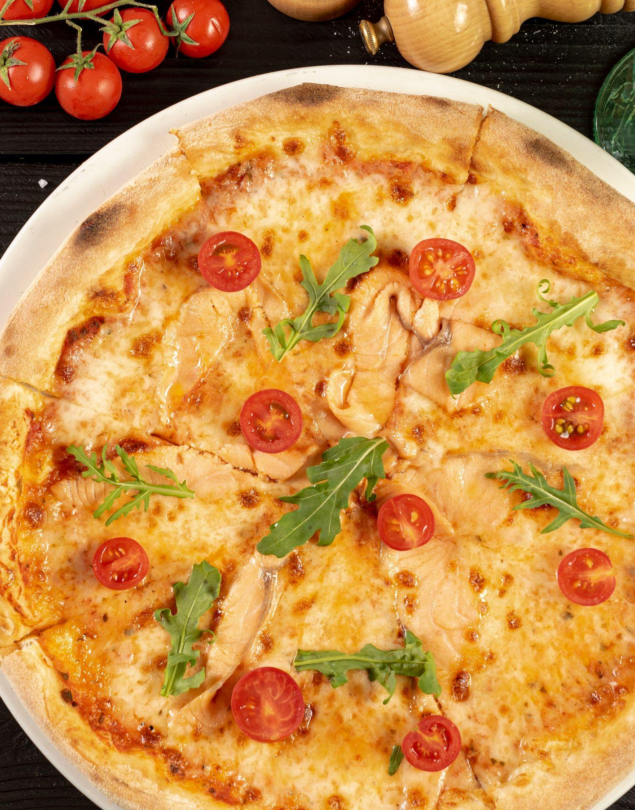
Thanks!
Do you have any questions?

